Slide 1
Scientific Method

Slide 2
Scientific Method
Steps that a scientist follows to test ideas

Slide 3
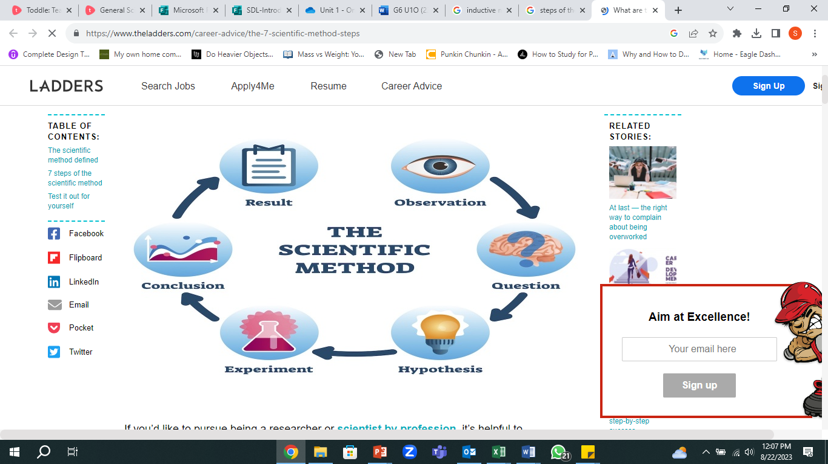
Overview of the Steps that scientists follow in the Scientific Method:

Slide 4
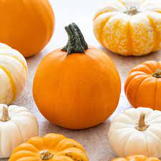
Example: Pumpkin throwing investigation to understand the parts of experiment design
Background research:
Pumpkin is vegetable which is very heavy and huge.
They come in different masses and sizes.
When throwing a pumpkin, it has to be thrown a certain way / technique so that it travels max. distance.
Research Topic: I want to investigate if the mass of a pumpkin will have an impact on the distance travelled by the pumpkin.
So, converting it into a question form –
Research Question: How does the mass of a pumpkin impact on the distance travelled by the pumpkin?

Slide 5
Variables in a Scientific experiment
In your experiment, the quantity that you change is called the Independent Variable.
In your experiment, the quantities that you control and keep as constant are called the Control Variables.
In your experiment, the quantities that depends on the independent variable and what you measure is called the Dependent Variable.
Notes:
Feedback 18th August: https://forms.office.com/Pages/ResponsePage.aspx?id=TtFtRMI33k2SNLUbYwoz7_hGo2pZNYRGlt1SbsjaSDhUMk9YUjdSQjBCRjBEVVk5MkNLVjdFMzlYTi4u
https://forms.office.com/Pages/ResponsePage.aspx?id=TtFtRMI33k2SNLUbYwoz7_hGo2pZNYRGlt1SbsjaSDhUMk9YUjdSQjBCRjBEVVk5MkNLVjdFMzlYTi4u

Slide 6
Variables in Pumpkin Throwing Investigation
Independent Variable (IV): Mass of pumpkin
Dependent Variable (DV): distance travelled, max. height attained
Controlled Variable (CV): the force applied to throw the pumpkin , the location where the experiment is taking place, the starting point

Slide 7
Clare wants to find out if water boils faster when salt is added to it or does it boil faster without salt added to it.
Independent Variable
Controlled Variables
Dependent Variable

Slide 8
Boiling water with / without salt experiment
Independent Variable
Controlled Variables
Dependent Variable
Water with or without salt
Pot Size
Quantity of water in pot
Amount of heat applied
Time the heat is applied for
Pots kept without stirring
Time required to boil the water

Slide 9
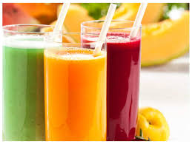
Practise:
A student thinks that orange juice will freeze faster than any other substance. She fills identical containers with the same amount of different liquids, and then places each in the freezer. She checks them every five minutes and discovers that the orange juice is the last one to freeze and the water is the first to freeze.
Independent Variable:
Dependent Variable:
Controlled Variables:
Hypothesis: If I pour orange juice in the ice tray then I think it will freeze faster because I have seen it happen before. (This can be valid or invalid and the student will have to do an experiment to see it is valid)

Slide 10
Practise:
A student thinks that orange juice will freeze faster than any other substance. She fills identical containers with the same amount of different liquids, and then places each in the freezer. She checks them every five minutes and discovers that the orange juice is the last one to freeze and the water is the first to freeze.
Independent Variable:Type of liquid
Dependent Variable: freezing time
Controlled Variables: identical containers, time, freezer, temp. settings of the freezer
Hypothesis: If I pour orange juice in the ice tray then I think it will freeze faster because I have seen it happen before. (This can be valid or invalid and the student will have to do an experiment to see it is valid)

Slide 11
Research question:
How does the mass of a ball affect the distance it travels?

Slide 12
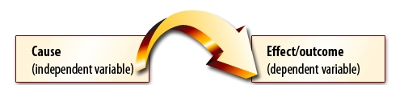
Independent Variable vs. Dependent Variable
 | Independent Variable | Dependent Variable
Also Known As: | Manipulated Variable | Responding Variable
Results: | Cause | Effect
When representing on a graph: | X axis | Y axis

Slide 13
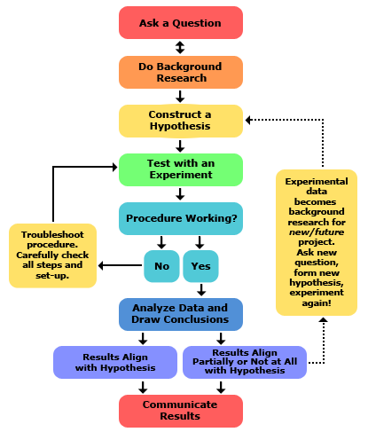
Steps in the Scientific Method with details:
Notes:
Explain this with Pumpkin throwing investigation

Slide 14
How to form a Hypothesis and identify variables in a scientific experiment
Learning objective: to understand how to develop a good
hypothesis in scientific experiments.

Slide 15

Testable Question
A testable question is one that can be answered by designing and conducting an experiment.
The answers to a testable question can be observed and measured.

Slide 16
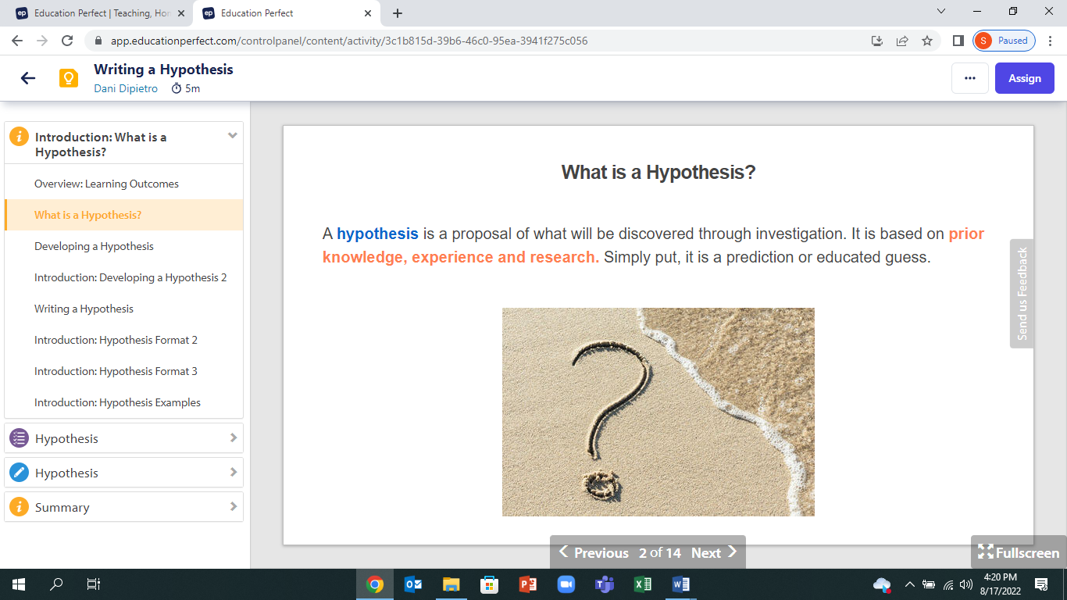
Hypothesis
Hypothesis- a testable explanation of an observation.
A hypothesis is is aproposal that will be discovered through investigation. It must be based on prior knowledge, experience and research.
We should be able to test it.
Hypothesis = Prediction + Reason

Slide 17
Tips to form a good hypothesis
The question comes first. Before you make a hypothesis, you have to clearly identify the question you are interested in studying.
A hypothesis is a statement, not a question. Your hypothesis is not the scientific question in your project. The hypothesis is an educated, testable prediction about what will happen.
Make it clear. A good hypothesis is written in clear and simple language. Reading your hypothesis should tell a teacher or judge exactly what you thought was going to happen when you started your project.
Keep the variables in mind. A good hypothesis defines the variables in easy-to-measure terms, like who the participants are, what changes during the testing, and what the effect of the changes will be.
Make sure your hypothesis is "testable." To prove or disprove your hypothesis, you need to be able to do an experiment and take measurements or make observations to see how two things (your variables) are related. You should also be able to repeat your experiment over and over again, if necessary.

Slide 18
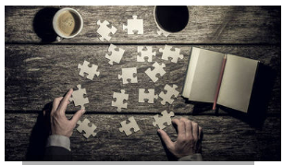
The Elements of a good hypothesis:
Written as a statement
Makes a prediction
Is testable
Gives an explanation based on facts , not opinions
Fits with the existing observations
Shows the relationship between independent and dependent variables

Slide 19
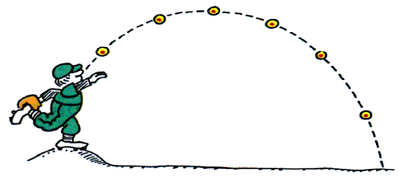
Ball 1 = 5kg
Ball 2 = 2kg
Ball 3 = 0.5 kg
Will the mass of the ball(IV) impact the distance it covers(DV)
Controlled variables: technique of throwing the ball, location
Hypothesis: If the mass of the ball is more, then I predict that it will travel a shorter distance, because I have observed that gravitational force on heavier objects is more
If (IV) then (DV) because scientific reasoning

Slide 20
What’s not a good hypothesis
I predict that one of the pumpkins will reach the furthest (not testable, not measurable, not specific)
What’s better:
I predict that if the 5kg pumpkin is thrown then it will travel the furthest distance because we have observed that lighter objects thrown will travel the furthest/ have least resistance to motion.
General Structure to form a good hypothesis:
If…(cause created by Independent Variable)..then…(effect on Dependent Variable).. because …you have observed/ heard/ seen/….an explanation

Slide 21
To sum up…
Research Question - What do you want to find out through the experiment
Hypothesis: used to check the ‘cause and effect’ relationship between the variables
- It is an educated guess or prediction done before the experiment
It has to be testable
It should be specific with the independent and dependent variables mentioned
It has to be simple and clear
Can follow the structure:
If ….. (Independent Variable)…. Then…(dependent Variable)….
because (states why you think the dependent variable will happen)
Notes:
Note: The “if” part of the hypothesis contains the independent variable, the “then” part has the
dependent variable, and the “because” states why you think the dependent variable will happen

Slide 22
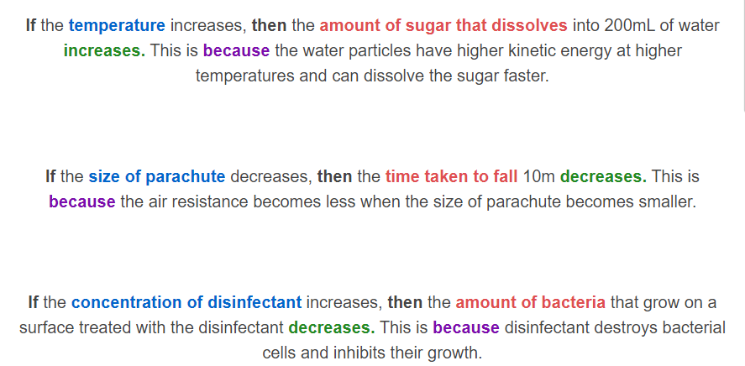
More examples of a hypothesis:

Slide 23
Learning objectives: Students will be able to-
Understand elements of an observation table
Reflect on improvements that can be made to the method
Safety and procedural precautions

Slide 24
Designing observation table (Testing the impact of mass of a ball(IV) on distance covered(DV)) :
Put an appropriate title for the table
Mention unit of measurement
Mass of pumpkin (kg) | Distance travelled (m) (Trial 1) | Distance travelled (m) (Trial 2) | Distance Travelled (m) Trial 3
5 | 2.6 | 2.4 | 2.55
10 | 1.4 | 1.1 | 1.2
15 | 0.5 | 0.57 | 0.34
Impact of mass of pumpkin on distance covered
Title of the table

Slide 25
Reflecting on improvements to method :
Human error in technique is possible;
Use an air cannon , sling or a catapult instead for accuracy
Sufficient number of trails are required

Slide 26
Safety and procedural Precautions:
Ensure there are no people standing in the launching area (starting point) of the pumpkin
Ensure there are no people standing in the landing area (ending point) of the pumpkin, so that they don’t get hurt
Use safety gear, like a helmet, safety goggles , etc.)
Clear area while handling heavy pumpkins so that no one gets hurt
Ensure proper launching technique is used while loading the pumpkin on the catapult so that they don’t get hurt
Notes:
Precautions that you take to ensure success of the experiment

Slide 27
Criterion B
Level 1 and 2 | Level 3 and 4 | Level 5 and 6 | Level 7 and 8
The student is able to: i) select a problem or question to be tested by a scientific investigation ii) select a testable prediction iii) state a variable | The student is able to: i) state a problem or question to be tested by a scientific investigation ii) state a testable prediction iii) state how to manipulate the variables, and state how data will be collected | The student is able to: i) state a problem or question to be tested by a scientific investigation ii) outline a testable prediction iii) outline how to manipulate the variables, and state how relevant data will be collected | The student is able to: i) outline a problem or question to be tested by a scientific investigation ii) outline a testable prediction using scientific reasoning iii) outline how to manipulate the variables, and outline how sufficient, relevant data will be collected

Slide 28
Criterion C
Level 1 and 2 | Level 3 and 4 | Level 5 and 6 | Level 7 and 8
The student is able to: ii. interpret data iii. state the validity of a prediction based on the outcome of a scientific investigation, with limited success v. state improvements or extensions to the method that would benefit the scientific investigation, with limited success | The student is able to: ii. accurately interpret data and outline results iii. state the validity of a prediction based on the outcome of a scientific investigation v. state improvements or extensions to the method that would benefit the scientific investigation | The student is able to: ii. accurately interpret data and outline results using scientific reasoning iii. outline the validity of a prediction based on the outcome of a scientific investigation v. outline improvements or extensions to the method that would benefit the scientific investigation | The student is able to: ii. accurately interpret data and outline results using correct scientific reasoning iii. discuss the validity of a prediction based on the outcome of a scientific investigation v. describe improvements or extensions to the method that would benefit the scientific investigation

